Slide 1
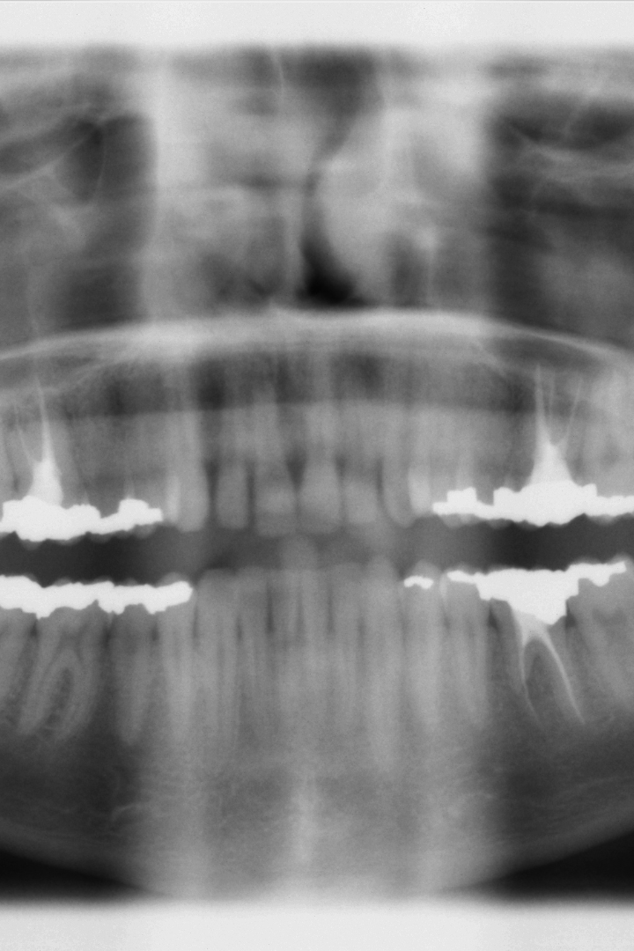
INTRA ORAL DENTAL X- RAY SENSORS
BIOMEDICAL SENSORS AND MEASUREMENTS
(AM5050)
PSP AND CMOS SENSORS
Kaviyarasan PR
AM23M025

Slide 2
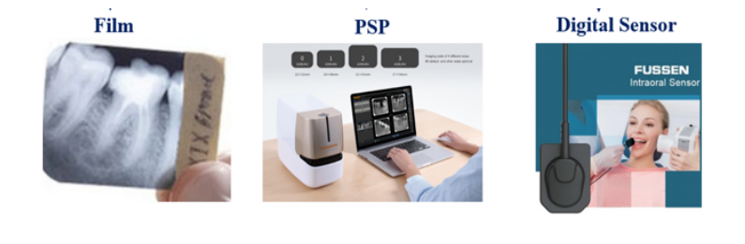
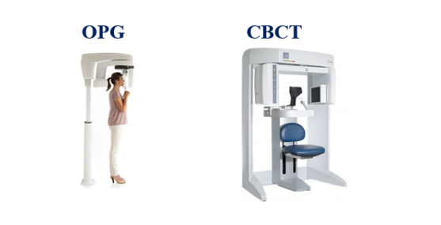
INTRA AND EXTRA ORAL SENSORS:
Dental X-rays, also known as dental radiographs, are commonly used in dentistry for various diagnostic and treatment purposes.
Intra oral and extra oral sensors for better diagnostics.
OPG - Orthopantomogram
CBCT - Cone Beamed Computer Tomography

Slide 3
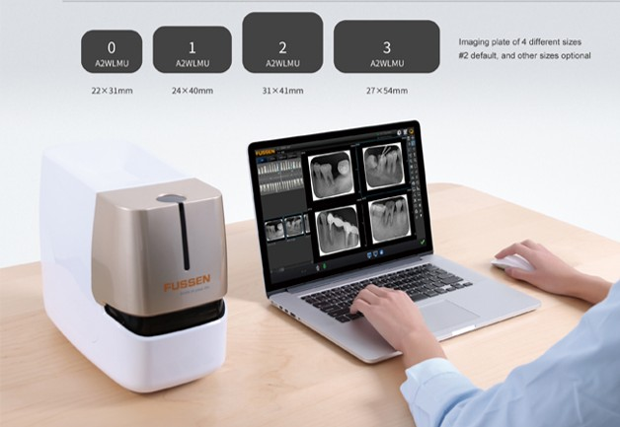
PHOTO STIMULABLE PHOSPHOR PLATES
Imaging Technique- photo-stimulated luminescence screens to capture the X-ray image, instead of traditional X-ray film.
Indirect digital image acquisition technique
Manufacturer: FUSSEN
Model:F200 · Imaging Plate Scanner
Components required
PSP Plates
PSP scanner
Software
https://en.fussengroup.com/Imaging/100.html

Slide 4
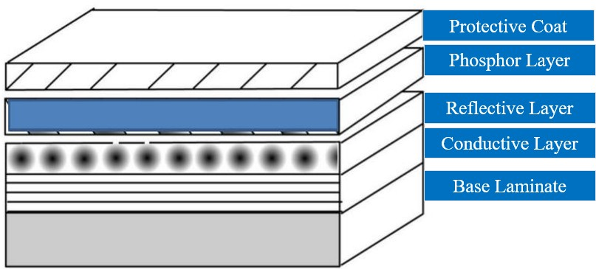
CONSTRUCTION
Protective layer - protects the plate from external trauma, dust and scratches.
Phosphor layer - photostimulable phosphor that traps EM radiation during exposure.
Reflective layer -reflects the light in forward direction, when energized by Laser & release to the Photo Multiplier Tube in Scanner.
Conductive layer -protects the plate from Static Electricity, & absorbs light to increase Image Sharpness & reduce artefacts.
Base Laminate - made of semi-rigid material, which provides strength and rigidity to the plate.

Slide 5
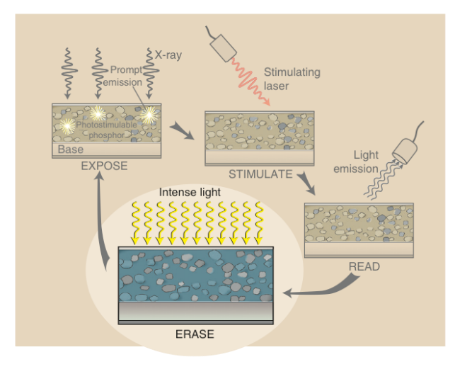
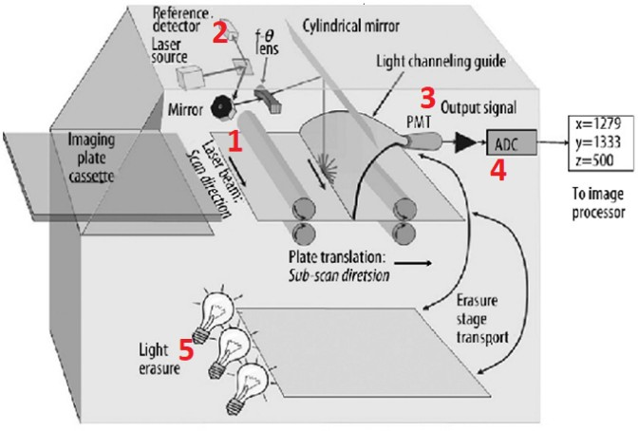
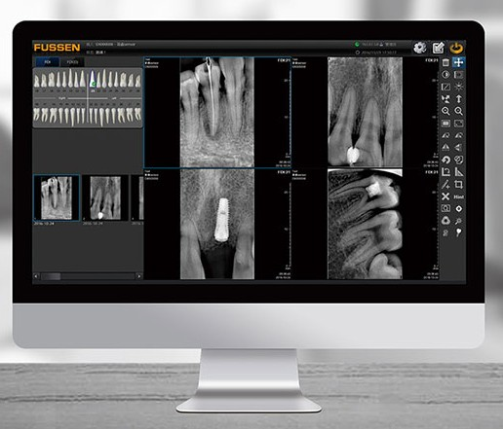
IMAGE ACQUISITION WITH PSP
Overview
Exposing the x-rays
Stimulating the phosphor
Reading the light emission by phosphor
Erasing the plate for the next exposure
Translational assembly – moves the plate
Laser assembly
PMT – reading
ADC – conversion
Erase assembly
Software reconstructs the image
Adjusts the quality etc.,
DICOM compatible

Slide 6
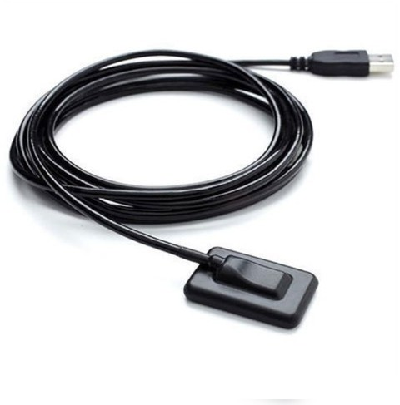
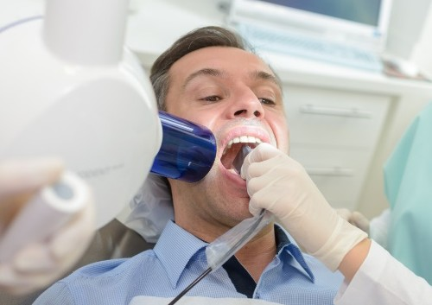
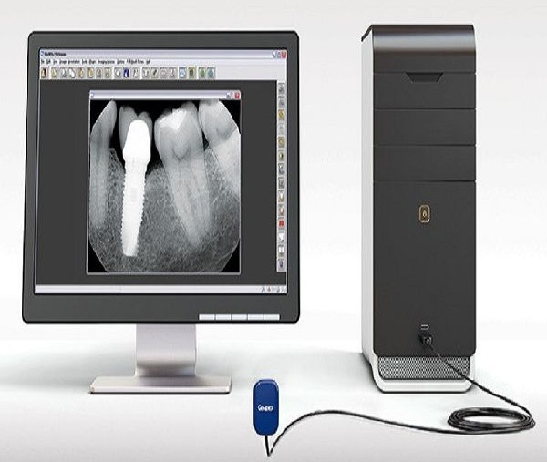
INTRA ORAL SENSORS
Direct radiography (DR) is an advanced form of x-ray imaging which is a direct image acquisition technique in which a sensor is used to take radiographic images and send electrical signals via leads to computer where they are converted to digital images that can be displayed on a monitor.

Slide 7
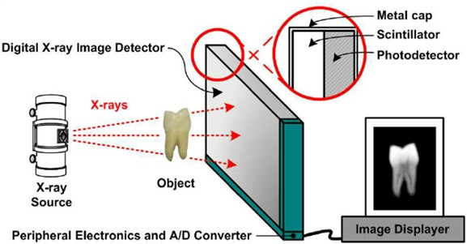
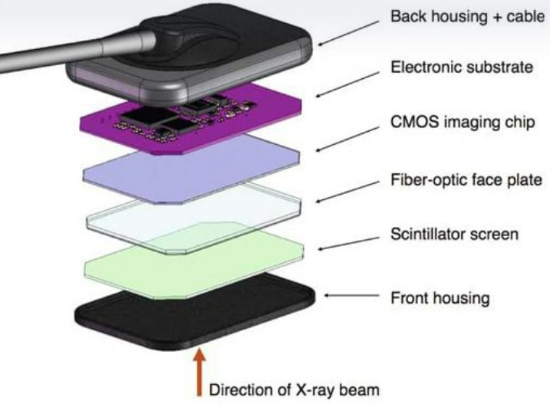
CONSTRUCTION
Manufacturer: FUSSEN
Model: F100 · Intraoral Sensor
Scintillators - Cesium Iodide (CsI) and Gadolinium Oxysulfide (Gadox)
Fiber optic plate – collimates the light onto the CMOS
CMOS - converts light from the scintillator into an electrical signal using photosensitive pixels

Slide 8
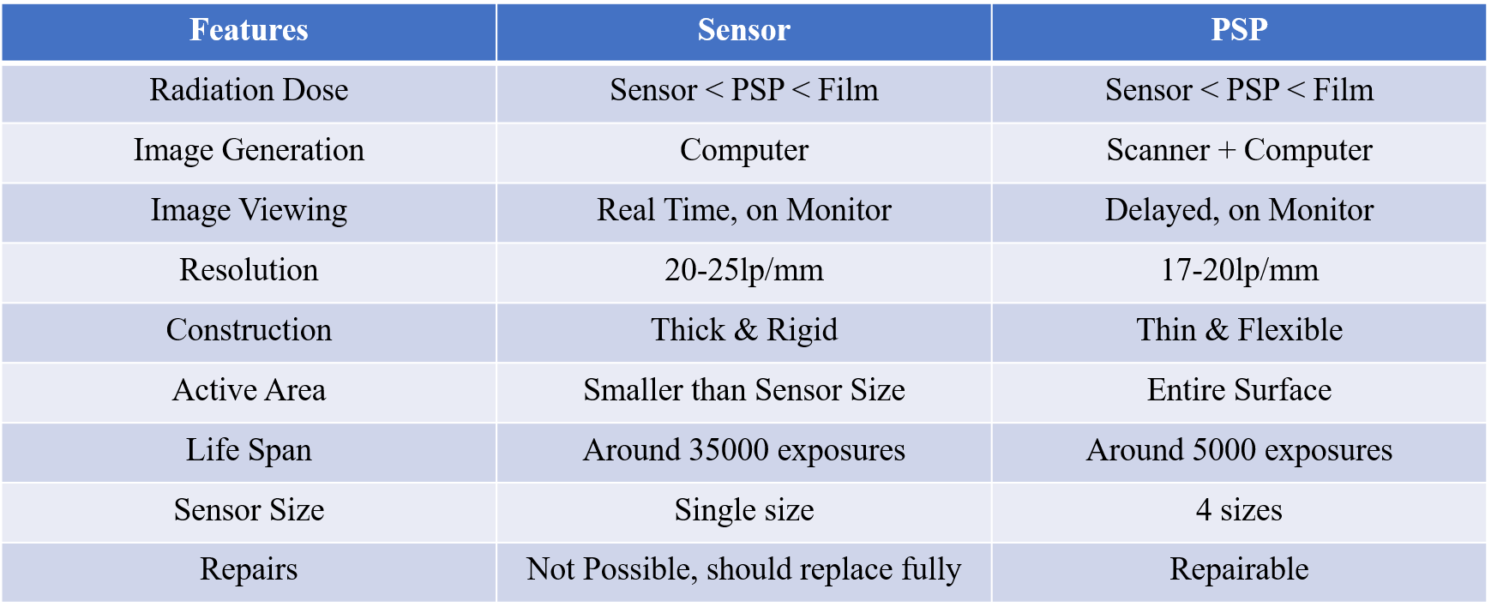
COMPARISION

Slide 9
REFERENCES
Kamburoğlu, Kıvanç, et al. "Clinical comparison of intraoral CMOS and PSP detectors in terms of time efficiency, patient comfort, and subjective image quality." Imaging Science in Dentistry 52.1 (2022): 93.
Mehralizadeh, S., S. Nemati Anaraki, and M. Orshesh. "Comparison of CMOS and PSP intraoral digital sensors in the diagnosis of secondary caries adjacent to amalgam restorations." (2017): 44-49.

